Slide 1
CS661: BIG DATA VISUAL ANALYTICS
VISUAL ANALYTICS OF AIR POLLUTANTS AND POLLUTION-RELATED HEALTH IMPACT IN INDIA

Slide 2
TEAM MEMBERS
Abhishek Srivastava
Anay Sinhal
Arth Banka
Happy Pachori
Pankaj Nirmal
Riktesh Singh
Saransh Shivhare
Tanmay Chhapola
Vaibhav Nalotia

Slide 3
ACKNOWLEDGEMENTS
We would like to thank our instructor Dr. Soumya Dutta for giving us an opportunity to work on this project which was a great learning experience.

Slide 4
INTRODUCTION
Problem: Air pollution is a major health threat in India due to rapid urbanization and industrialization.
Solution: We propose a visual analytics project to analyze air quality data and its impact on respiratory health.
Data: We have used a comprehensive air quality dataset (2021-2023) from Kaggle, including pollutants like ozone, CO, SO2, NO2, PM10, and PM2.5.
Our project provides insight into:
Temporal trends: How air quality changes over time.
Spatial distribution: How pollution varies across different regions.
Health impacts: Impact of air pollution on respiratory health outcomes.
Goal: To visualize air quality data in India and highlight the urgency of addressing air pollution for public health. Our solution will be an interactive web-based visualization platform, enabling users to explore and analyze the AQI data and its health implications across India with ease and precision.

Slide 5
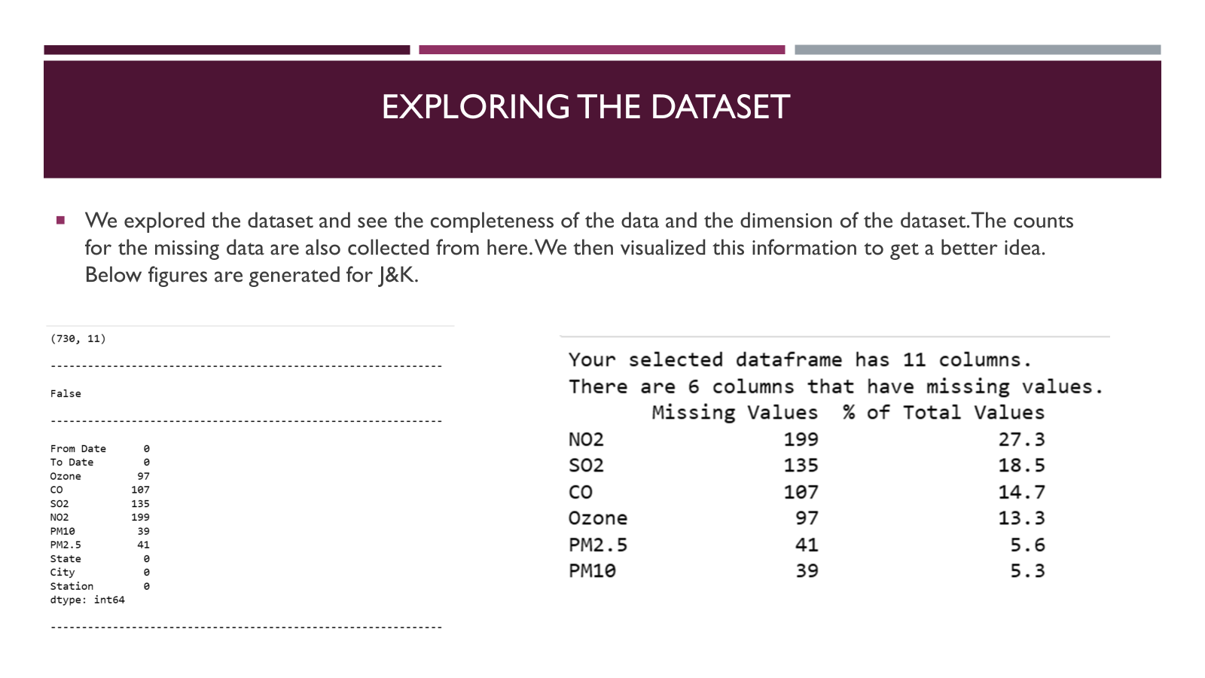
DATASET DESCRIPTION
This analysis explores air quality in India from 2021 to 2023. We'll leverage a rich dataset sourced from Kaggle, featuring:
Over 3 years of daily AQI measurements across Indian states and territories.
Granular details including Ozone, CO, SO2, NO2, PM10, and PM2.5 levels.
Metadata like date range, state, city, and monitoring station for precise analysis.
This comprehensive dataset allows us to uncover trends and variations in air quality across India, providing valuable insights into this critical issue.

Slide 6
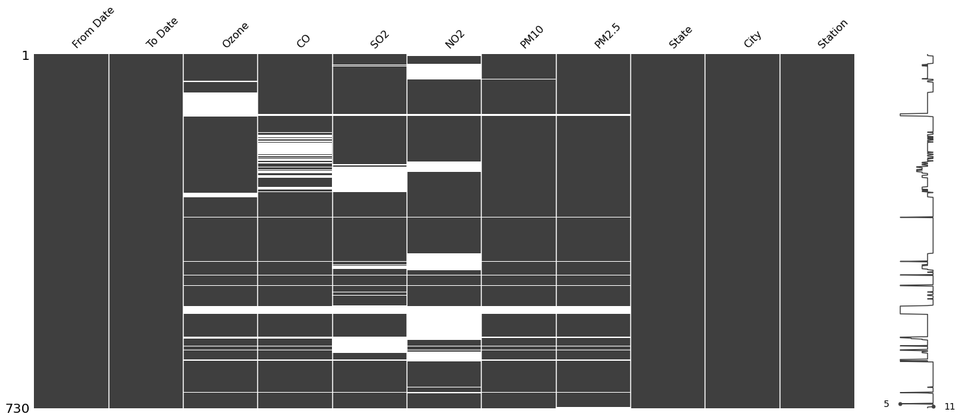
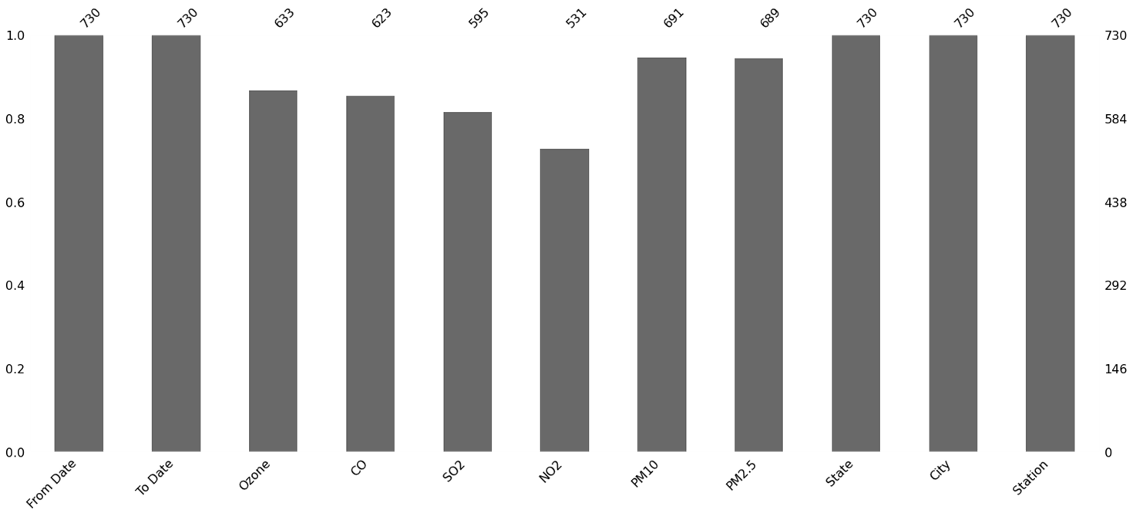
VISUALIZING THE LOCATIONS OF THE MISSING DATA
In the next step we tried to observe if there are any patterns to the missing values. We generated a matrix using the missingno library in python.
The plot appears blank where there are missing values. The graph on the right side gives the general shape of the completeness of the data and points out the row with the minimum nullities and the total number of columns in a given dataset, at the bottom.

Slide 7
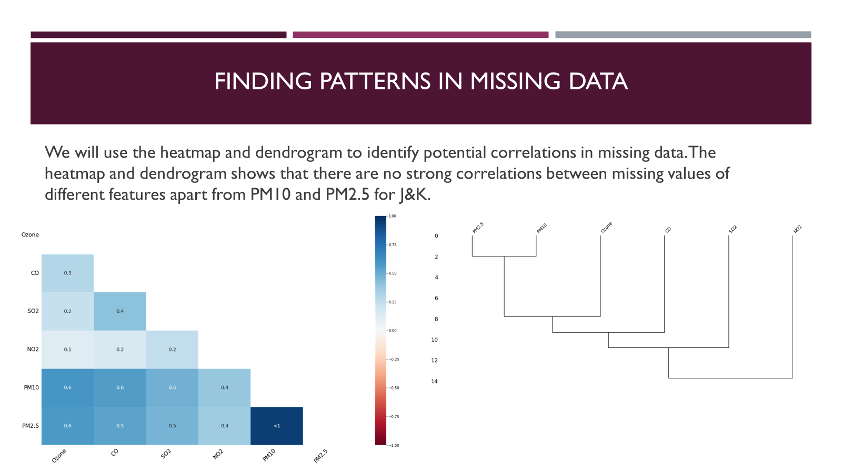
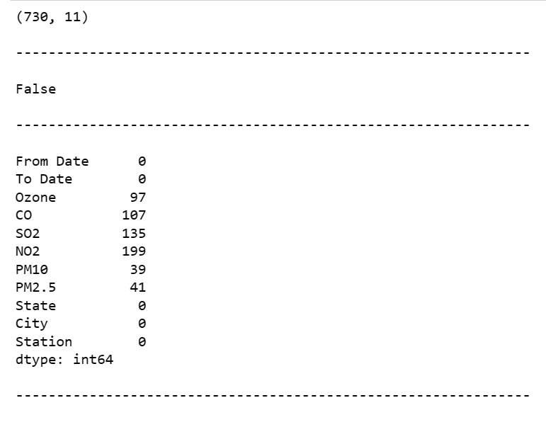
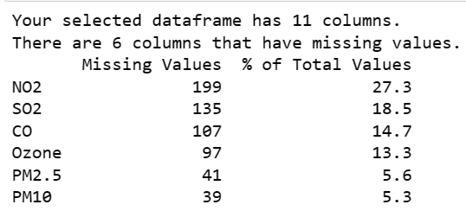
EXPLORING THE DATASET
We explored the dataset and see the completeness of the data and the dimension of the dataset. The counts for the missing data are also collected from here. We then visualized this information to get a better idea. Below figures are generated for J&K.

Slide 8
DATA PRE-PROCESSING
Since the data is time series data. fillna() method was used for imputing missing values in some cases. Basic Imputation Techniques that were used were:
Linear interpolation method
The KNNImputer class provides imputation for filling in missing values using the k-Nearest Neighbors approach. Each missing feature is imputed using values from nearest neighbors that have a value for the feature. The feature of the neighbors were then averaged uniformly rather than weighting by distance to each neighbor.
Multivariate imputation by chained equations (MICE): A strategy for imputing missing values by modeling each feature with missing values as a function of other features in a round-robin fashion. It performs multiple regressions over random sample of the data, then takes the average of the multiple regression values and uses that value to impute the missing value.

Slide 9
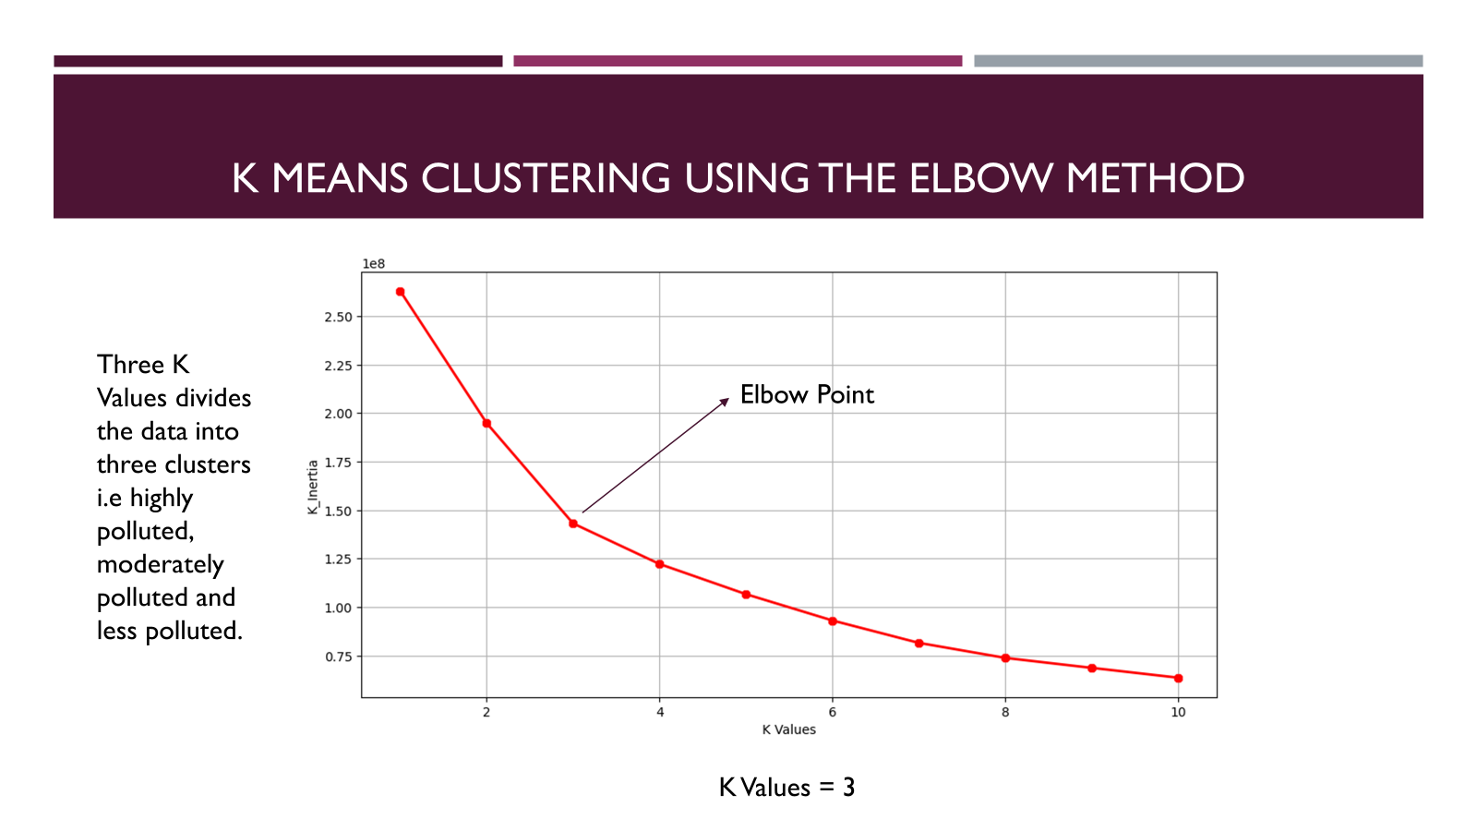
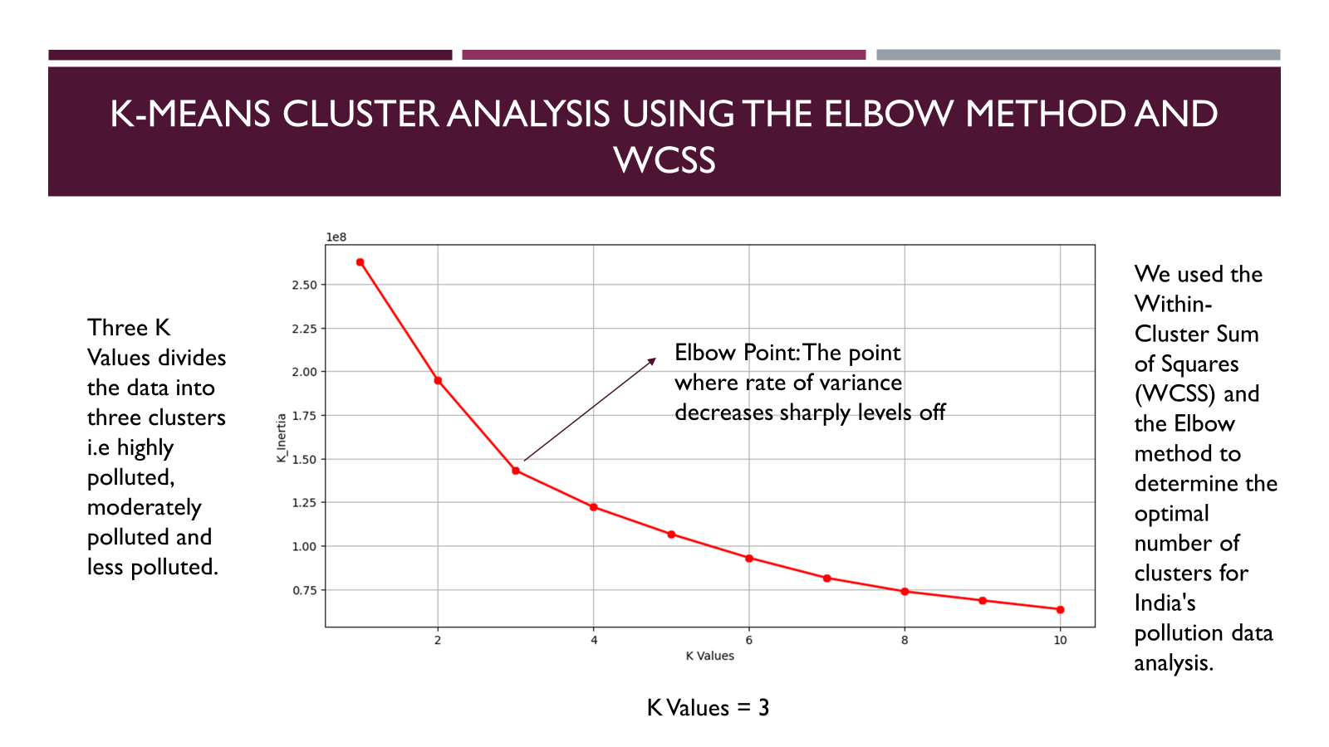
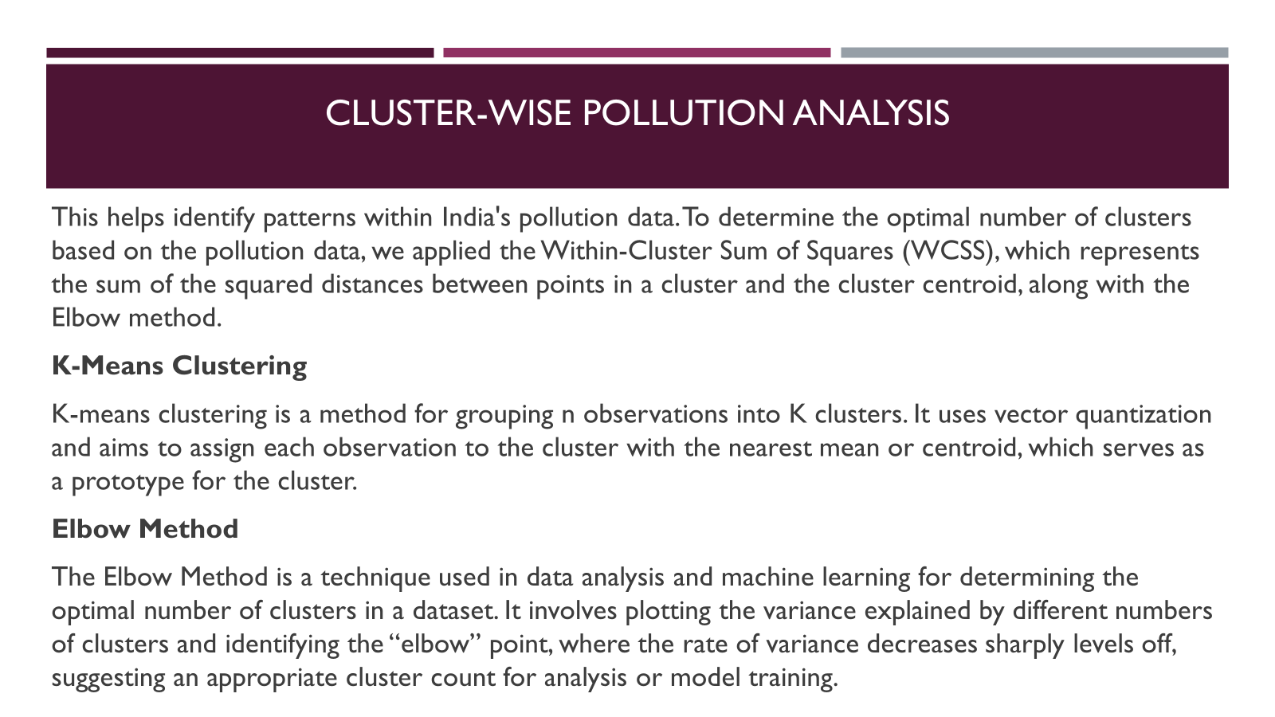
THANK YOU!
We would be pleased to hear your feedback and take up any questions you may have.

Slide 10
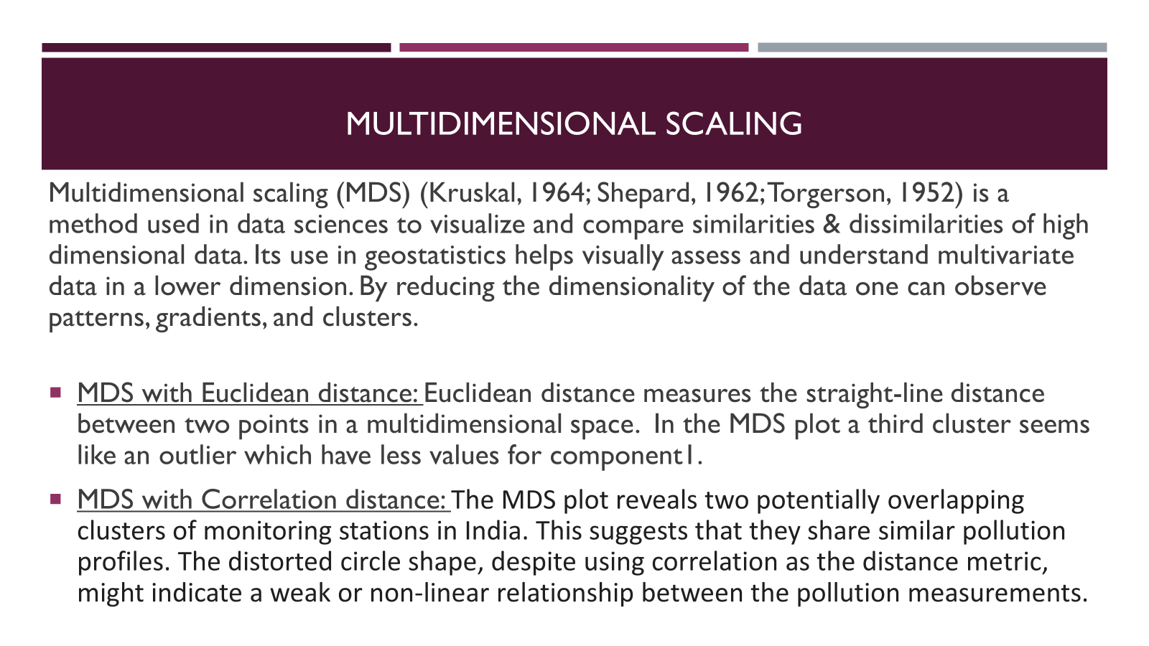
THANK YOU!
We would be pleased to hear your feedback and take up any questions you may have.

Slide 11
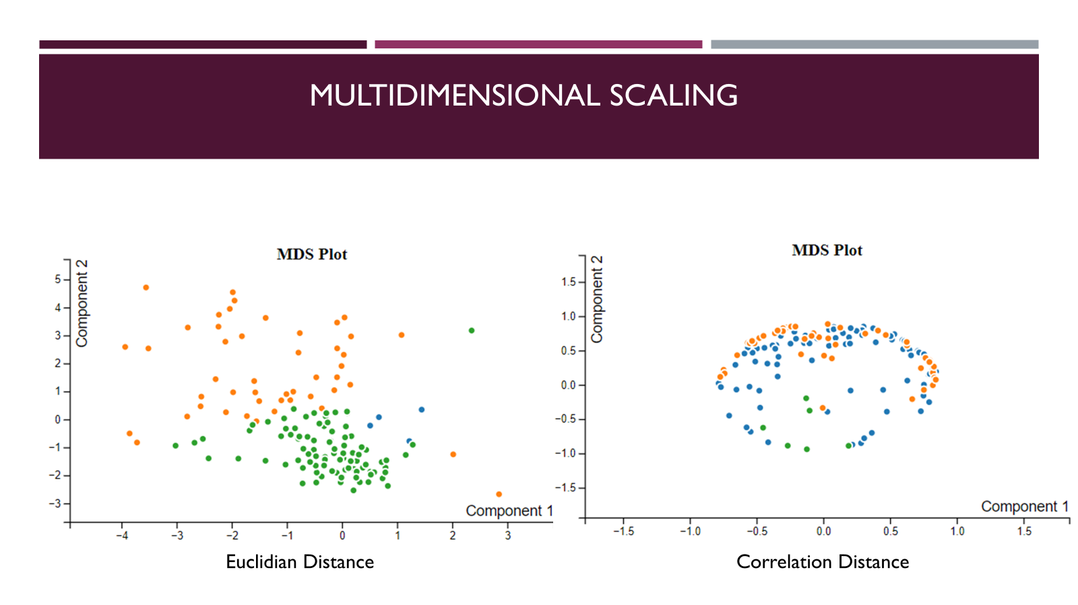
THANK YOU!
We would be pleased to hear your feedback and take up any questions you may have.

Slide 12
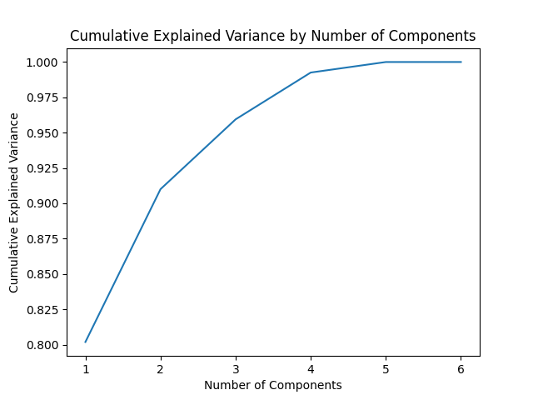
DIMENSIONALITY REDUCTION TECHNIQUES
We have included two dimensionality Reduction Techniques i.e. PCA and t-SNE into Air Quality Index Dashboard.
PCA is a widely-used linear technique that efficiently reduces the dimensionality of high-dimensional data while preserving as much variance as possible. It identifies the most significant patterns in the data by projecting it onto orthogonal principal components.
t-SNE is a nonlinear technique that preserves the local
and global structure of high-dimensional data in
low-dimensional embeddings. It is particularly effective
at capturing complex relationships and revealing
underlying patterns that may not be apparent in the
original data space.

Slide 13
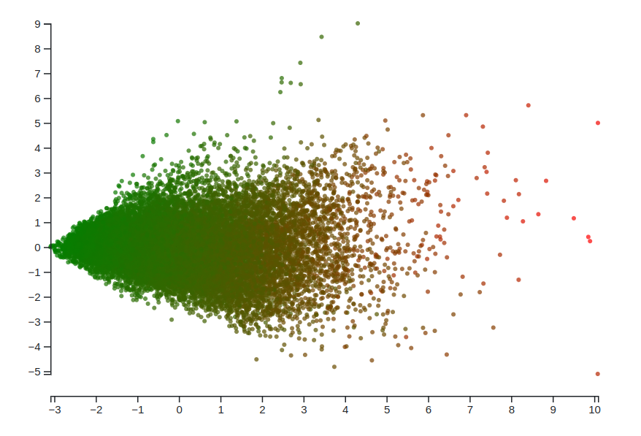
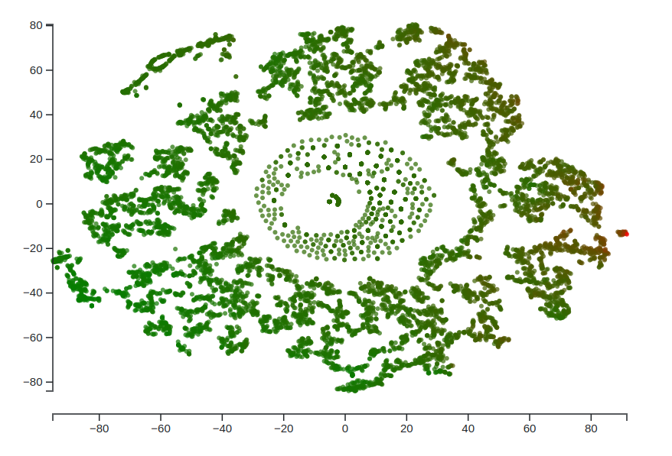
INFERENCES DERIVED FROM PLOTS
This Principal Component Analysis (PCA) plot depicts the variation of air quality data across different locations. Each dot represents a measurement, with colors indicating the Air Quality Index (AQI):
Green: Favorable air quality
Red: Unfavorable air quality
The data used to calculate AQI includes:
Ozone (O3)
Sulfur Dioxide (SO2)
Nitrogen Dioxide (NO2)
Carbon Monoxide (CO)
Locations with similar air quality conditions tend to cluster together in the plot. The direction and length of the axes represent the factors that most influence the variation in air quality.
Notes:
Potential Outliers: There are a few data points scattered far from the main clusters, These outliers could represent locations with unique air quality conditions or potentially indicate errors in the data collection process. Further investigation into these outliers might be necessary.
Dominant Pollutants: While it's difficult to say definitively from the t-SNE plot alone, the spread of the data points suggests that no single pollutant is solely responsible for air quality variations. There likely complex interactions between the four pollutants measured (ozone, SO2, NO2, and CO) that influence the overall AQI.

Slide 14

Visualization Of Pollutants on the map of India:
Preprocessed the dataset to make pollutant wise and month wise average valued json data.
Created an interactive map displaying air pollution levels across Indian states based on different pollutants. Upon selection, the map dynamically updates to display color-coded state boundaries indicating pollution levels (the darker the color, the more is the concentration).

Slide 15
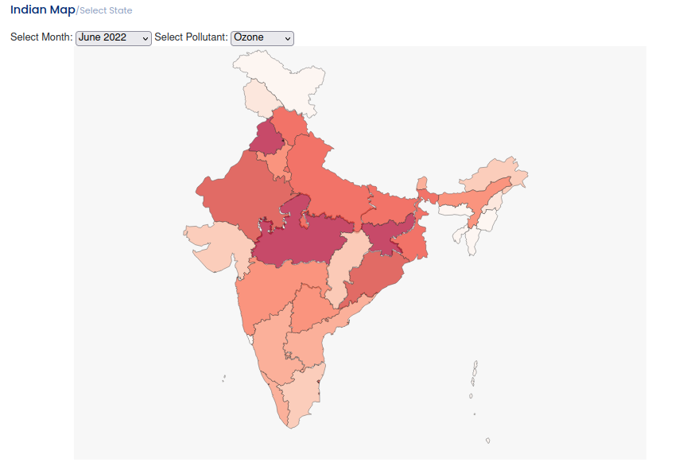
Visualization Of Pollutants on the map of India:
Upon selection of the state, the timeseries plot, parallel coordinates plot and PCA plot gets displayed for that state showing the responsive nature of the integrated plots. It also shows the state name and particular pollutant value for the selected month and pollutant on clicking any state on the map.

Slide 16
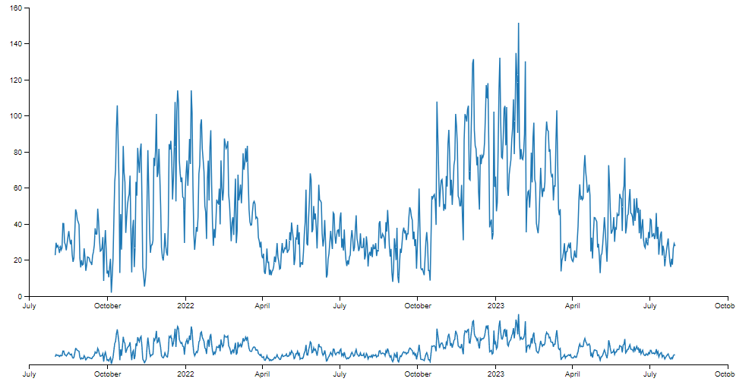
TIME SERIES ANALYSIS
Time series analysis benefits greatly from interactive visualization techniques that allow for deeper insights into the data. By adopting Ben Shneiderman's mantra of "Overview, zoom and filter, then details-on-demand," this enable users to navigate through complex datasets effectively.

Slide 17
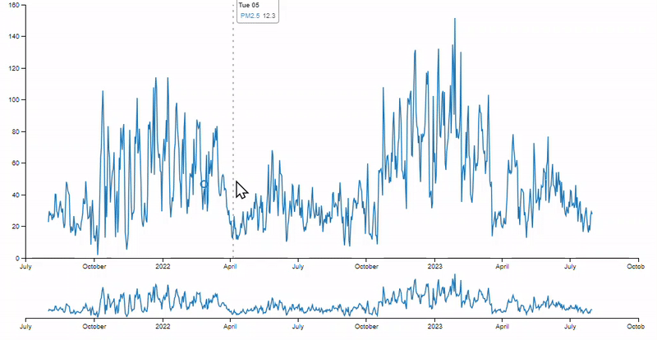
TIME SERIES ANALYSIS
Overview: Begin with a comprehensive view of the entire time series data to understand the overall trends and patterns.
Zoom and Filter: Utilize interactive brushing to zoom in on a particular time span. This focused approach helps analysts to identify anomalies, trends, or events that require closer examination.
Details-on-Demand: Once a region of interest is identified, additional details can be revealed upon interaction. This might include precise values, comparative analysis, or annotations explaining significant data points.

Slide 18
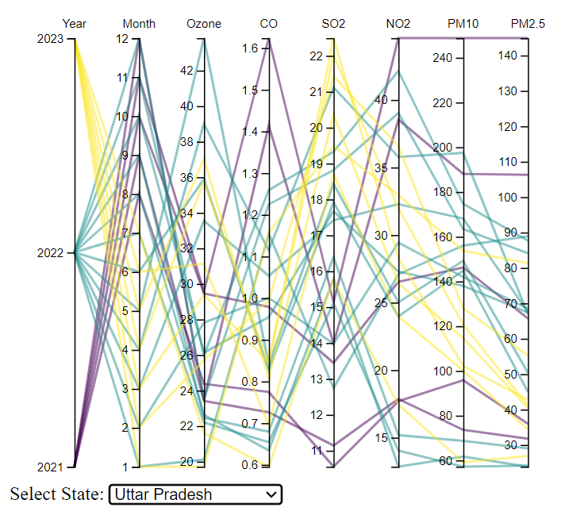
COMPARISON OF POLLUTANTS ACROSS YEARS
A parallel coordinate plot is graphical method where each observation or data point is depicted as a line traversing a series of parallel axes, corresponding to a specific variable or dimension.
In our case, the parallel coordinates plots shows the corresponding amount of pollutants in a selected state for any particular year and month of the year.

Slide 19
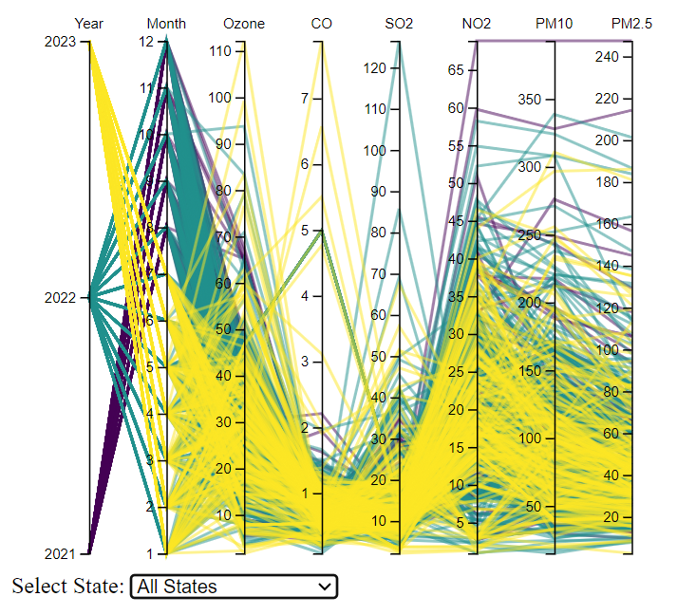
COMPARISON OF POLLUTANTS ACROSS YEARS
The primary advantage of using a parallel coordinate plot is its capacity to represent multivariate data and correspondence between multiple variables in a 2d space.
Initially, the parallel coordinate plot of the combined data from all the states is shown.
On selecting a particular state, the plot updates itself to show only the plot of the selected state.
Parallel lines, converging lines, and diverging lines can all indicate distinct relationships between the variables they represent in a parallel coordinate plot.

Slide 20
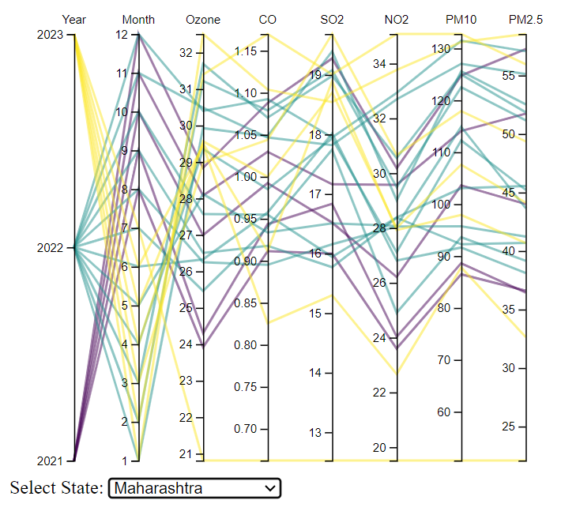
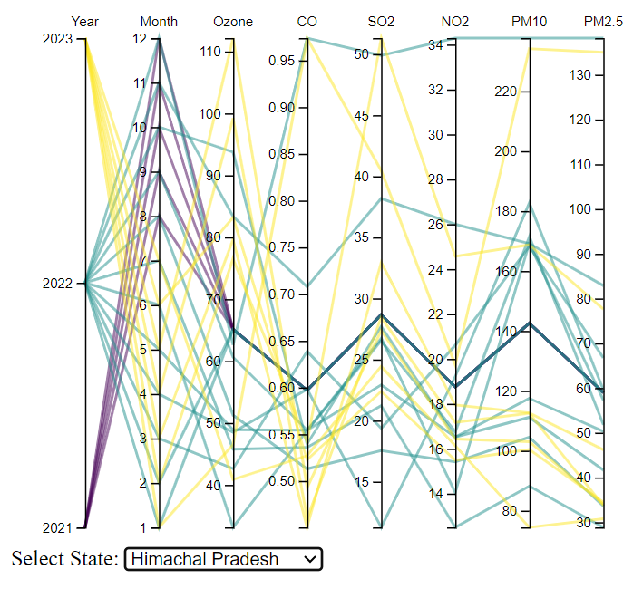
COMPARISON OF POLLUTANTS ACROSS YEARS
The average of level of pollutant “CO” in Himachal Pradesh is much less than that in Maharashtra in the years 2022 & 2023.

Slide 21
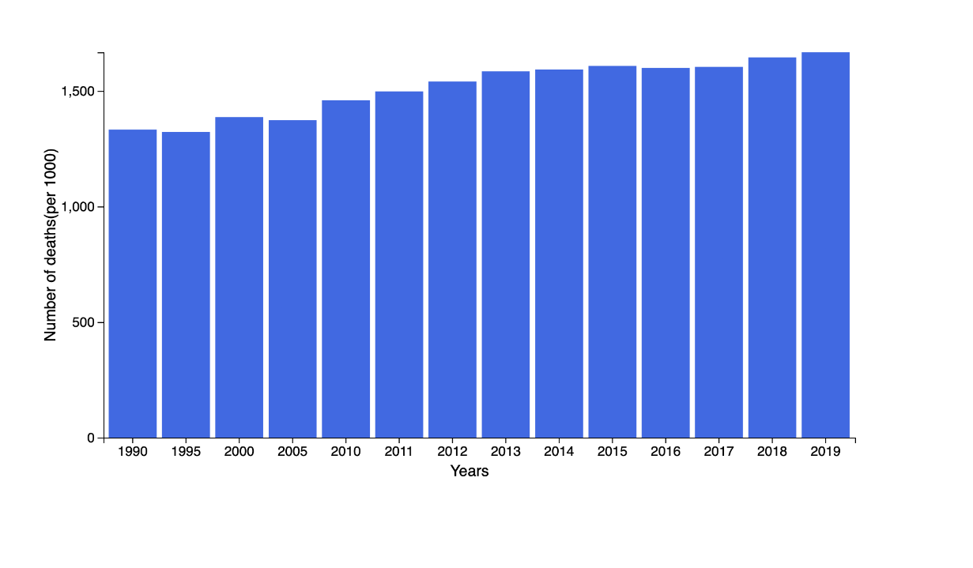
DISTRIBUTION OF DEATHS ACROSS YEARS
Used D3.js to plot a simple bar chart showing deaths caused due to air pollution in India over three decades
Used scale functions and alignments to place bars within the svg container
Data Source : https://www.statista.com/statistics/935666/india-average-annual-deaths-from-air-pollution/

Slide 22
Work Contribution
Abhishek Srivastava: Parallel Coordinates Plot
Anay Sinhal: Time Series & Proposal
Arth Banka: Data Preprocessing
Happy Pachori: Elbow Plot & MDS Plot
Pankaj Nirmal: Death Distribution Graph
Riktesh Singh: India Map & Dashboard Integration
Saransh Shivhare: PCA & t-SNE Plots & Dashboard Integration
Vaibhav Nalotia: Time Series & Proposal
Tanmay Chhapola: Final Report

Slide 23
THANK YOU!
We would be pleased to hear your feedback and take up any questions you may have.

